Slide 1

Train Accident Data Analysis

Slide 2
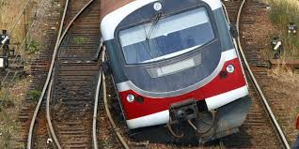

Question of Interests
Whether train has become safer in the US, and what can be improved to make it safer?
Notes:
1. train is till a major transportation for both goods and human.
2. Whether train is safer than other vehicle, no total passenger carried

Slide 3
Data Strategy & Sourcing
Understanding existing train accidents in US:
Whether safe:
Investigate total number of accidents against years
Investigate total number of fatalities against years
What to be improved:
Primary cause for these existing accidents
Any location with more accident numbers
Any factor is proved to be correlated to fatality
Primary: Rail Equipment Accident/Incident Data from FRA in the US Department of Transportation
Info available: recording details of accidents, e.g., time related, equipment type, weather, railroad etc.
Available records: 214K rows and 159 columns recording from year 1975 till 2022.
Data
Source:
Notes:
1. Government body, with a form available to record information of each accident

Slide 4
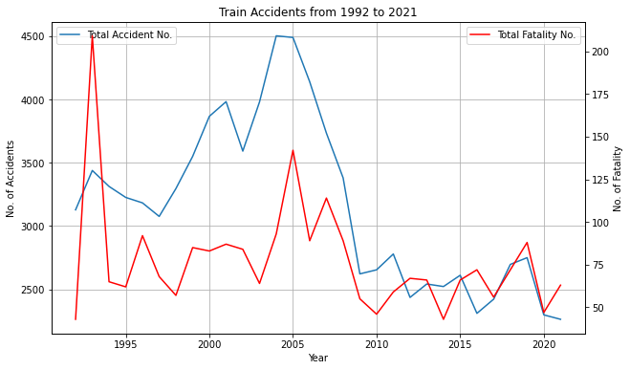
Data Manipulation & Analysis
Total number of accidents & fatalities?
Each row of the dataset is a record, and count rows to get total accidents
“Total Persons Killed” is available and using the sum() function
Generate a line plot to show their trending performances
10-year average number of accidents and fatalities are calculated to further prove trends

Slide 5
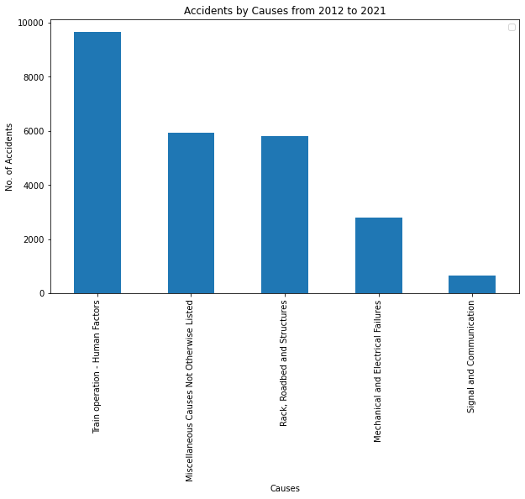
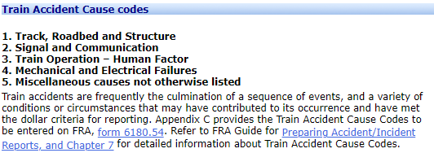
Data Manipulation & Analysis
Primary causes for existing train accidents?
“Primary Accident Cause Code” is recorded (each accident is only with one primary cause)
The file with all codes is available from FRA (390 codes in total), categorized into 5 causes (available below)
Generate a bar plot showing the total number of accidents under each cause
Source: FRA Office of Safety Analysis
Notes:
human factors like employee physical condition, train operations
track: track geometry, anchoring, appliances
Miscellaneous like crossing, environment related

Slide 6
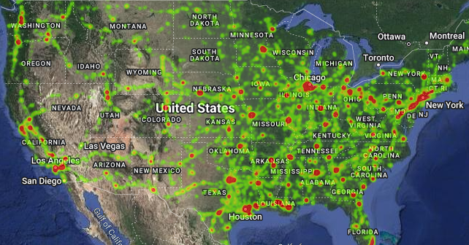
Data Manipulation & Analysis
Any location with more accident numbers?
“Latitude” & “Longitude” of accident locations are recorded in datasets
Generate a heatmap to show any place with higher accident occurrences

Slide 7
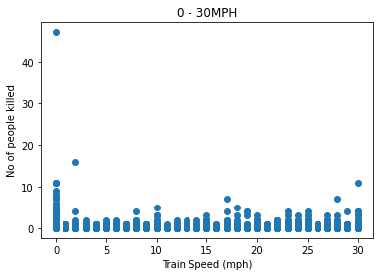
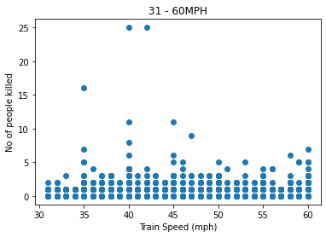
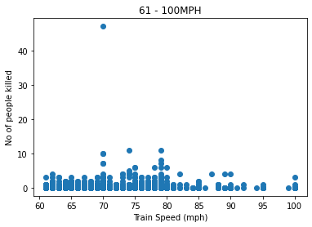
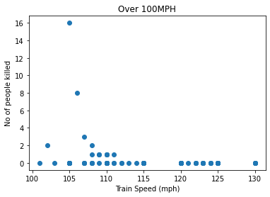
Data Manipulation & Analysis
Any factor is proved to be correlated to fatality?
“Train Speed” is available, and there are 214154 records with speed info for recorded 47 years (the max 545 mph is ignored)
Speed is divided into 4 segments:
0-30 mph; 31-60 mph; 61-100 mph; over 100mph
Scatter plots and linear regression are adopted to qualitatively and quantitatively see whether any correlations (all absolute r_values are below 0.2)

Slide 8


Summary
The total number of train accidents has reduced to an average level of 2,500 for 10 years (2012-2021) from an average level of 3,500 (1992-2001, 2002-2011); while for fatalities, the 10-year average level has reduced from 80 (1992-2001, 2002-2011) to 65 (2012-2021).
The data imply that in the US train has become safer between 2012 – 2021, but some limitations of this conclusion include impacts of covid-19 with fewer train movements are not considered.
The human factor is the primary cause for years between 2012-2021, specifically among 24,832 accidents 38.9% is due to human factors; location-wise, many major cities like New York, Chicago, and Houston are still with high occurrences, which suggests that more resources may be invested on staff training and these cities to improve overall train safety in the US.
Notes:
No total number of accidents

